Slide 1
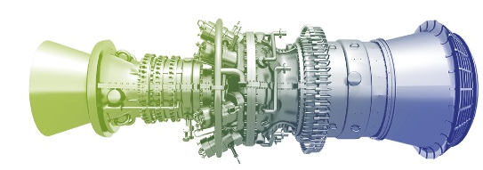
Introduction to Machine Learning for Managers
With Plenty
Of Examples
Ram Narasimhan

Slide 2
apprendimento

Slide 3
Apprendimento automatico

Slide 4

2006

Slide 5




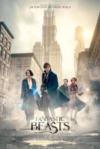





Slide 6
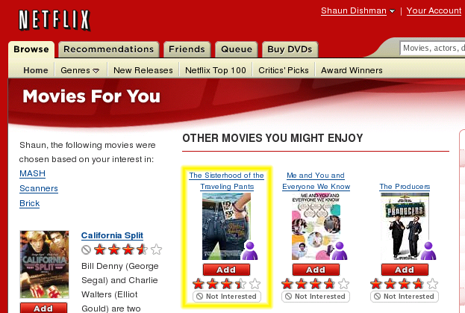
Netflix Prize – To Beat CineMatch
Oct 2, 2006
$1,000,000 (10%)
$50,000/yr (1% improvement)
By Oct 8th
By Oct 15th – 3 teams
Not Dummies
Not Geniuses
Unprecedented Cooperation

Slide 7
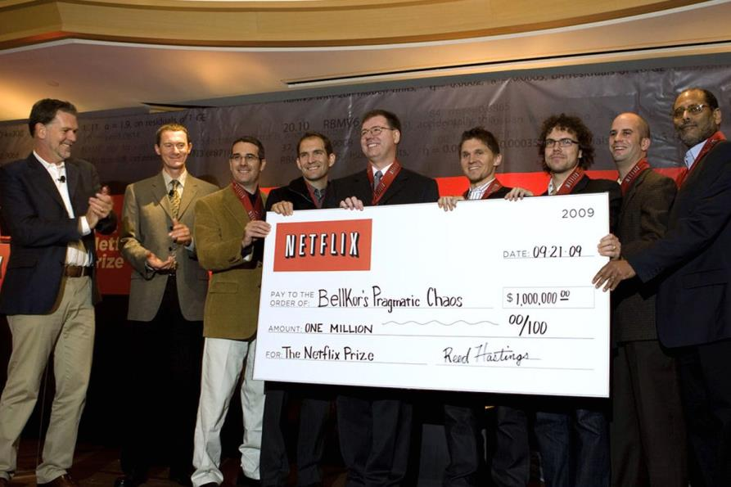

Slide 8
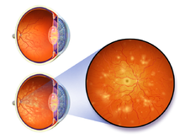
State of the Art in 2017
Diabetic Retinopathy
Stage 1?
Stage 2?
Stage 3?
Stage 4?

Slide 9
Ma.chine Learn.ing [muh-sheen lur-ning] [-noun]
"Field of study that gives computers the ability to learn without being explicitly programmed"
“a branch of artificial intelligence in which a computer generates rules based on raw data that has been fed into it"
The field of machine learning studies the design of computer programs able to induce patterns, regularities, or rules from past experiences.

